Slide 1
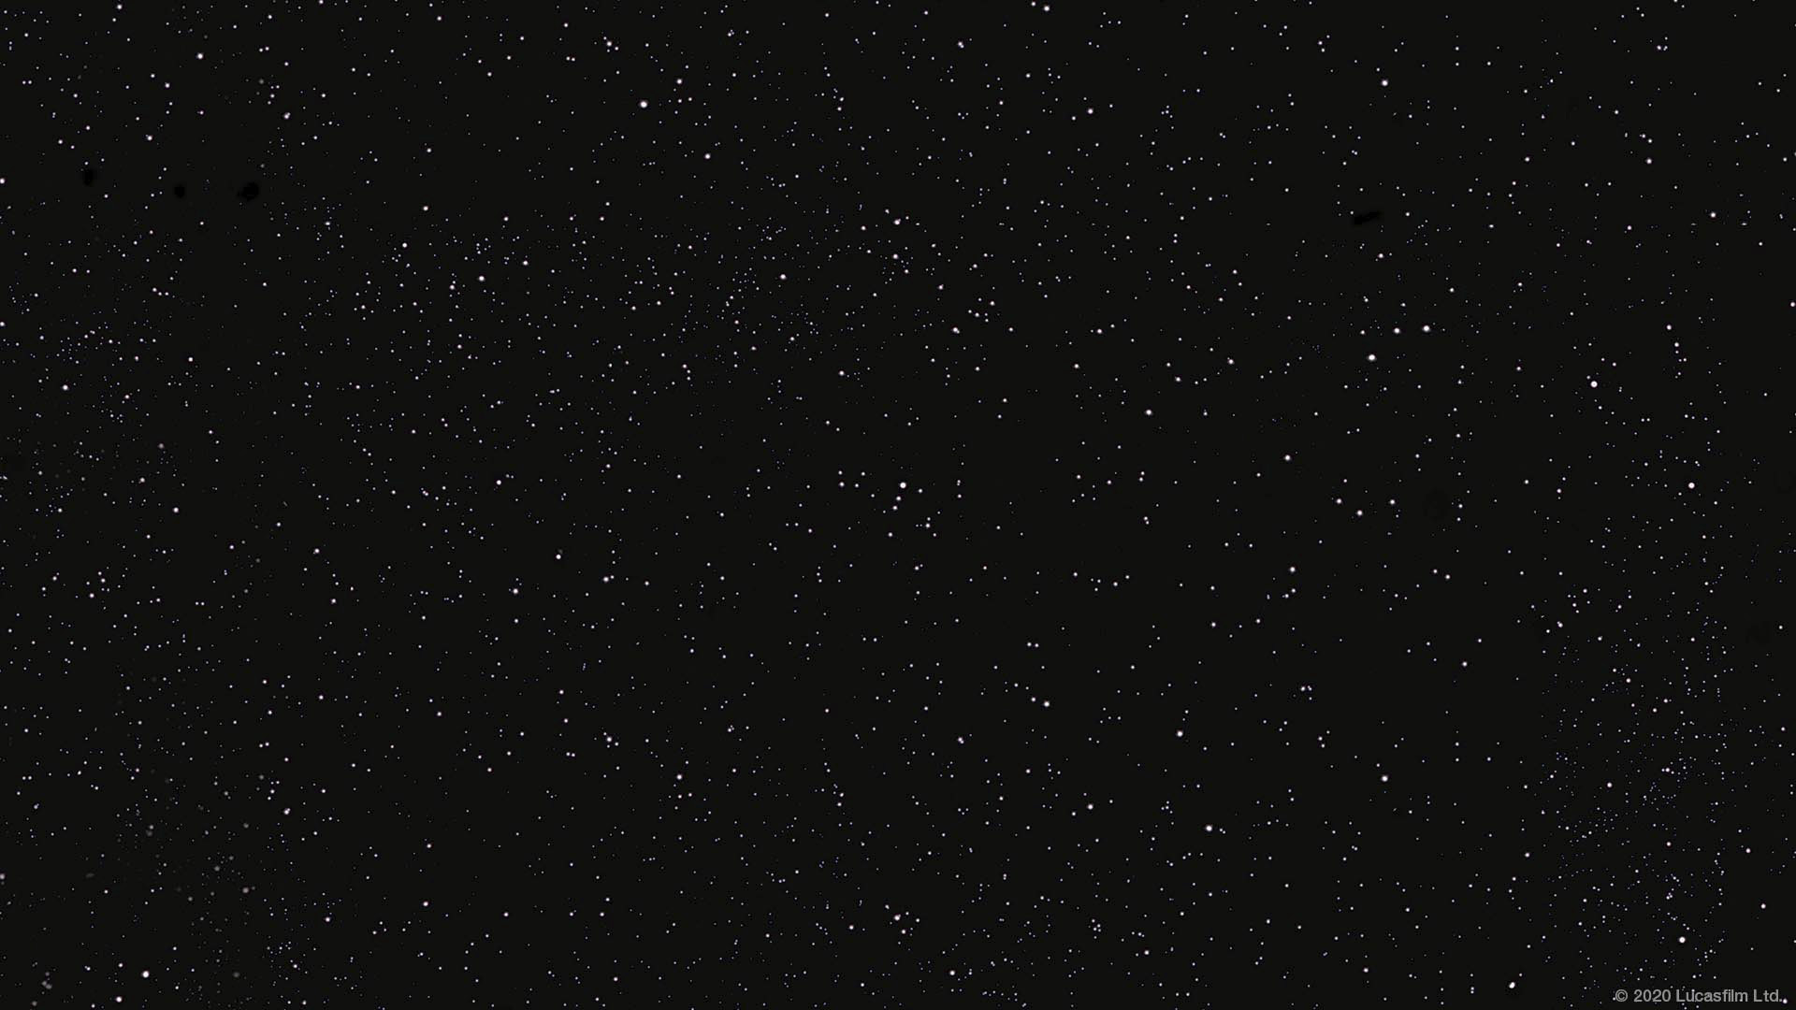
Group Seven Imperial Credit Predictions by: Savannah Jones, Megan Toale, Gabby Doty, Katie Bardwell

